Slide 1
Buoy Project
Brian Wilcove and Santos Sanchez

Slide 2
Goals:
Develop a cheap alternative to most high frequency buoy’s.
Take pH and temperature(1m and 2m) readings every hour
Host these readings on a webpage in a graph format

Slide 3
Deciding how to build
Settling on an instructables guide to making a buoy, we began.
http://www.instructables.com/id/BUOY/

Slide 4
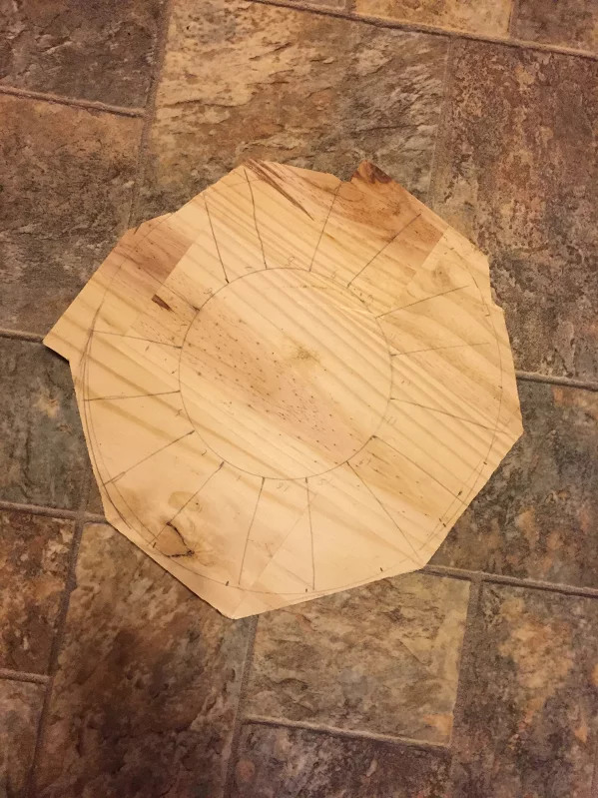
Creating the buoy
Apparently it’s hard to plan and draw projects without rulers and other equipment
First attempt went…poorly

Slide 5
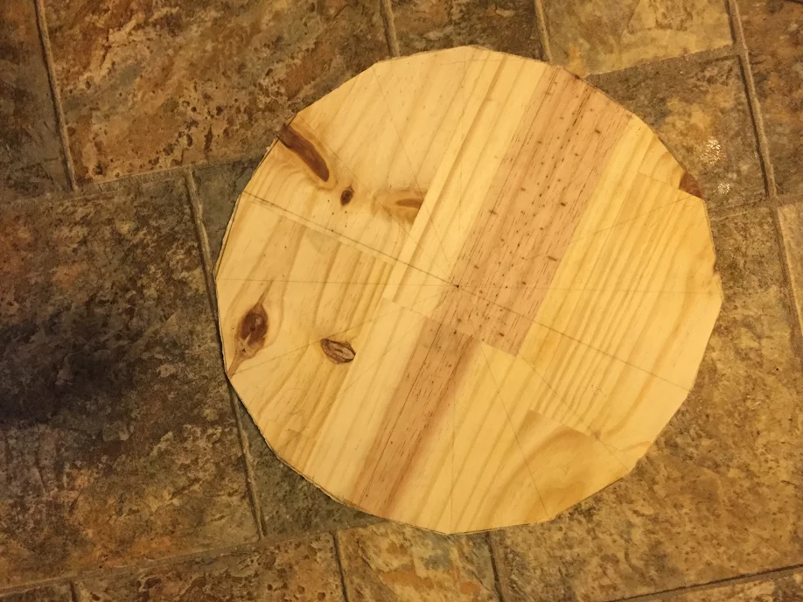
Second try!
Success!!!

Slide 6
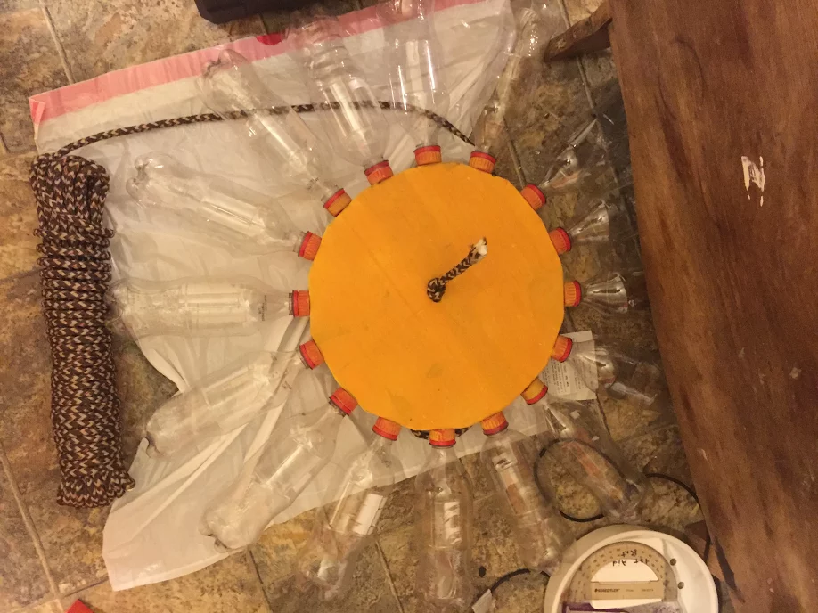
Finished Buoy

Slide 7
Wiring the temperature sensors
Most of our temperature sensor readings we had done in class.
Hooking up another one involved wiring another temperature sensor in the same place on the breadboard
Used solder to ensure the wiring will stay under stress.

Slide 8
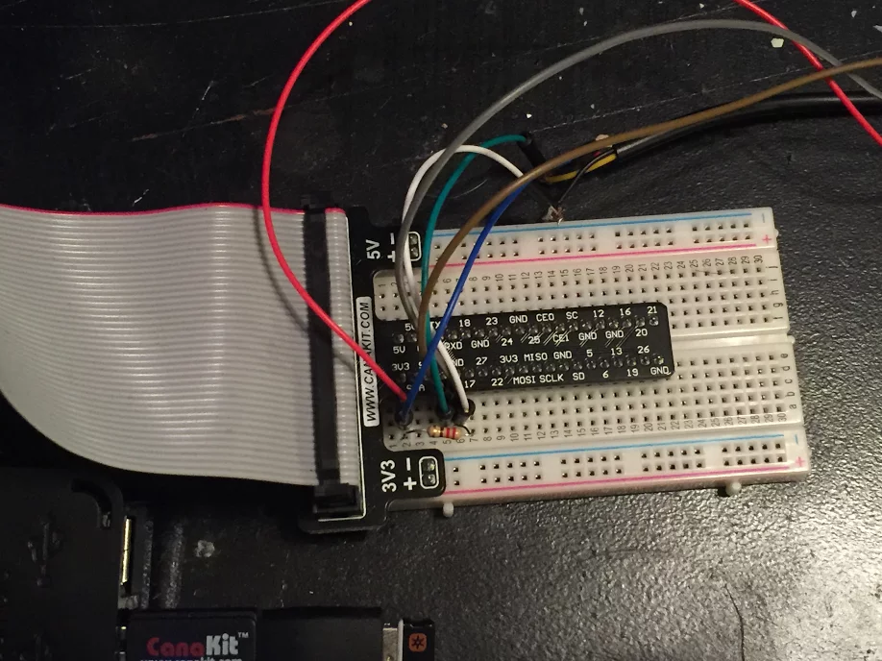
Temperature sensor

Slide 9
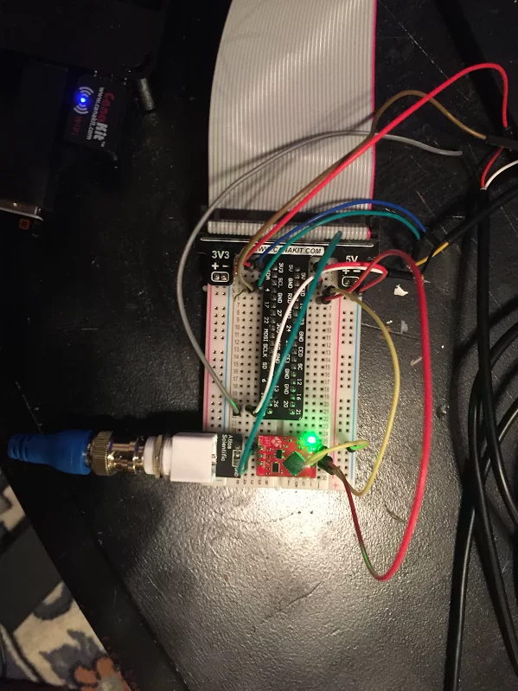
Adding the pH Probe
pH probe was a little more tricky.
Required some special wiring and special code taken from the probe’s website to take readings
Issue: Required Special Terminal window…

Slide 10
pH Probe
Could not get to work in time for project ☹
However, they do have their own new software that would have done 100% of the project for us
Titled: Eniac
We felt this was cheating so we opted to forgo this software

Slide 11

Programming
The data collection is done in python and collected into a sqlite3 database.
This database is then sent from one pi to a central repository using bash

Slide 12
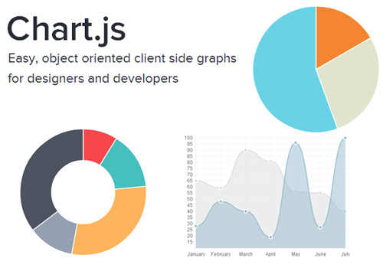
Programming (cont.)
The website built with flask and is hosted via digital ocean
We used chart.js to create our chart
Uses both HTML and Javascript
http://198.199.77.252

Slide 13
Languages used
Python does all of our data collection
Bash takes the file and sends it to the server
Crontab automates this to happen around every 30 minutes
HTML is used to create what is displayed on the website
Javascript used to create the data graph(chart.js)

Slide 14
Thing we’ve learned
Making physical things is hard and takes a lot longer than one might think
Using specialized sensors is surprising easy once you know what commands to give it
Jumping into any language is hard to do with no background in the subject
PAY ATTENTION TO DIRECTORIES

Slide 15
Questions?

